Slide 1

UE22CS320B – Capstone Project Phase – 2
Project Progress Review #2
Project Title : Efficient AI-driven Edge Surveillance using Edge Computing
Project ID : PW25_DS_01
Project Guide : Prof. Dinesh Singh
Project Team : Herman Singh Umrao (PES1UG22AM067)
Govind Subramanian (PES1UG22CS222)
Akshaj B Seerpu (PES1UG22AM018)
Uday V (PES1UG22CS662)

Slide 2
Efficient AI-driven Edge Surveillance using Edge Computing
Outline
Abstract and scope.
Suggestions from phase-1
Design Approach.
Design constraints, Assumptions and Dependencies
Architecture
Proposed methodology/Approach
Datasets exploration and Preprocessing
Project Progress Plan for Phase 2
References
Any other Information

Slide 3
Efficient AI-driven Edge Surveillance using Edge Computing
Abstract and Scope
Abstract This project presents an efficient edge-AI based CCTV surveillance system designed for medium-footfall institutional facilities. The system leverages existing CCTV infrastructure combined with edge computing devices to perform real-time video analytics without requiring significant cloud resources.
Processing data at edge helps reduce latency for AI based detection, at the same time helping with security and also lowering required bandwidth. Our proposal will use very lightweight computer vision algorithms optimized for deployment on the edge to perform some of the monitoring tasks such as people detection, occupancy tracking, and anomaly detection.
Our proposed architecture allows facilities to upgrade their conventional CCTV systems with the capability for AI, while minimizing infrastructure cost while maintaining data privacy. Key features in the proposal include real time monitoring, local data processing, customizable alerts, and basic analytics reporting.
This system is designed for facilities that have 50 to 500 people coming daily, making it perfect for smaller and medium-sized institutions that want a less expensive, uncomplicated security system without the complexity of cloud-based or server based solutions.

Slide 4
Efficient AI-driven Edge Surveillance using Edge Computing
Abstract and Scope
Problem Statement
Small companies/businesses cannot afford to have a server/cloud platform to perform analytics.
Tracing actions of a person within the facility premises, requires the user to watch multiple footages from different cameras.
Scope:
This project focuses on developing an AI-driven edge surveillance system that enhances real-time monitoring while minimizing infrastructure costs and privacy risks. Its key principles include:
Real-Time AI Video Analytics – Lightweight models for people detection, occupancy tracking, and anomaly detection with customizable alerts.
Edge Computing – Local processing on low-power AI devices to reduce cloud dependency and latency.
Optimized Resource Utilization – Use of efficient AI models (YOLO, FaceNet) to run on limited hardware.
Scalability & Deployment – Designed for medium-scale institutions (50-500 visitors/day) with easy integration into existing CCTV setups.
Privacy & Security – Local data storage ensures compliance with privacy regulations and prevents unauthorized data access.

Slide 5

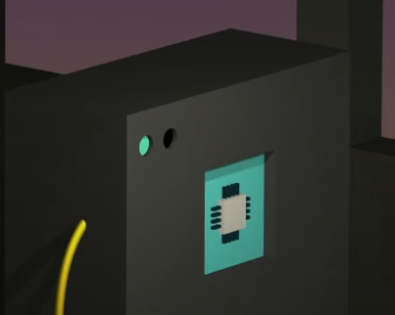



Efficient AI-driven Edge Surveillance using Edge Computing
Edge Computing
traditional cloud computing
while using cloud for iot application
while using edge computing
edge devices

Slide 6
Efficient AI-driven Edge Surveillance using Edge Computing
Currently available Edge-AI features on cctv
Motion Detection
Line-Crossing Detection
Facial Recognition
Human Detection
Intrusion Detection

Slide 7
Efficient AI-driven Edge Surveillance using Edge Computing
Features that we want to implement
Decentralization (serverless architecture)
Each camera has web server capabilities.
Easier traceability of one person across multiple cameras
by using simplistic and minimal AI models.

Slide 8
Efficient AI-driven Edge Surveillance using Edge Computing
Design Constraints, Assumptions & Dependencies
We believe in using the following in phases for the System design of our project:
Phase 1:
4 X laptops with webcams
Phase 2:
4 X (Raspberry Pi 3A+ / Raspberry Pi zero)
4 X (Micro SD cards)
4 X (cis cam) (3-5 mp)

Slide 9
Efficient AI-driven Edge Surveillance using Edge Computing
Design Constraints, Assumptions & Dependencies
We have started testing out on raspberry pi and had some amount of success on that. We believe the current available platform should be good enough for the required compute. If there is a case where we require more, we can switch to “orange pi zero” or “banana pi zero” .

Slide 10
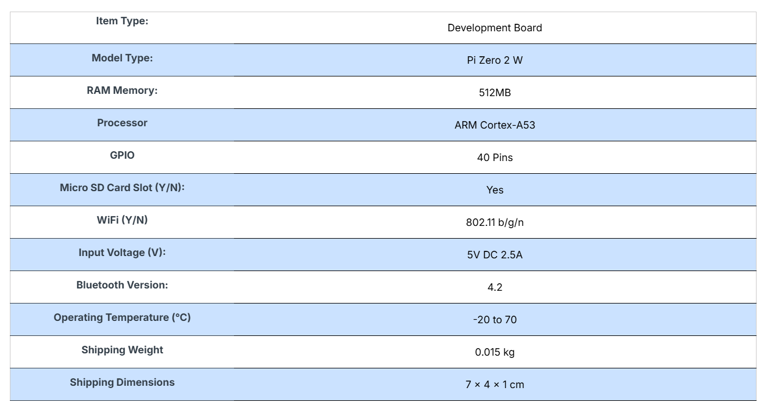
Efficient AI-driven Edge Surveillance using Edge Computing
Raspberry pi zero2W specifications

Slide 11
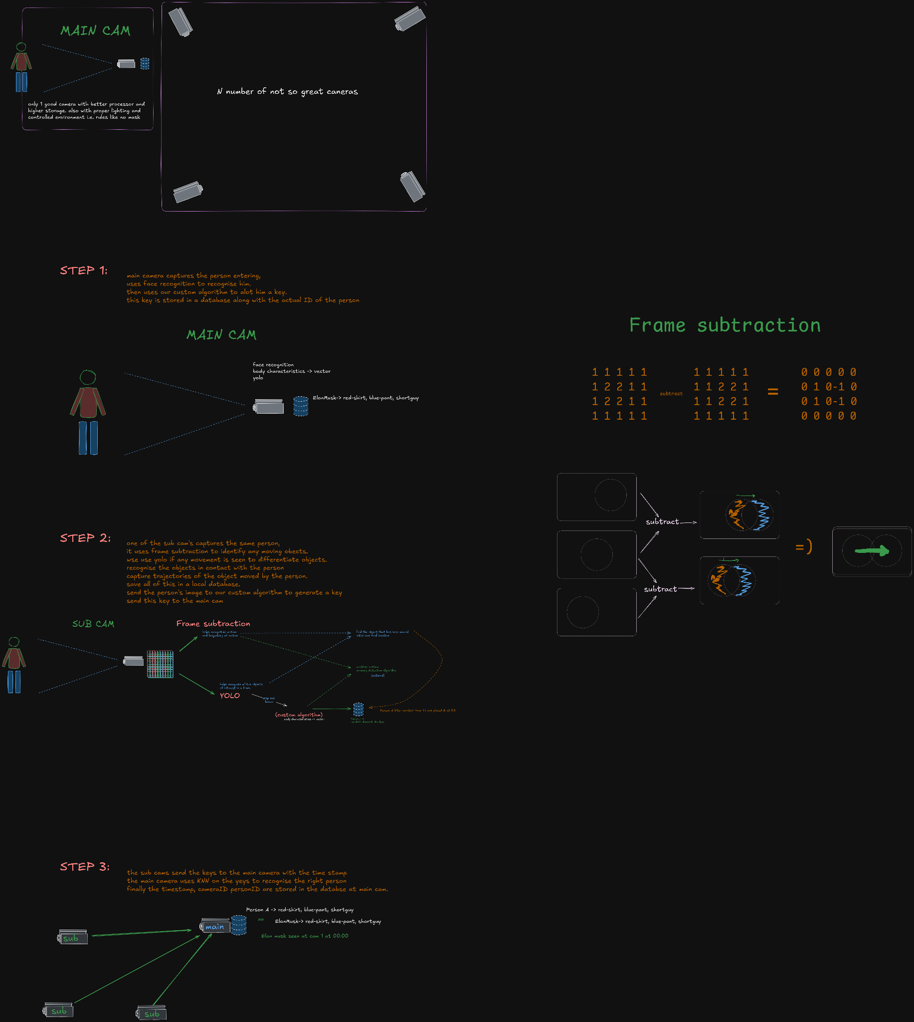
Efficient AI-driven Edge Surveillance using Edge Computing
Architecture

Slide 12
Efficient AI-driven Edge Surveillance using Edge Computing
Proposed Methodology / Approach

Slide 13
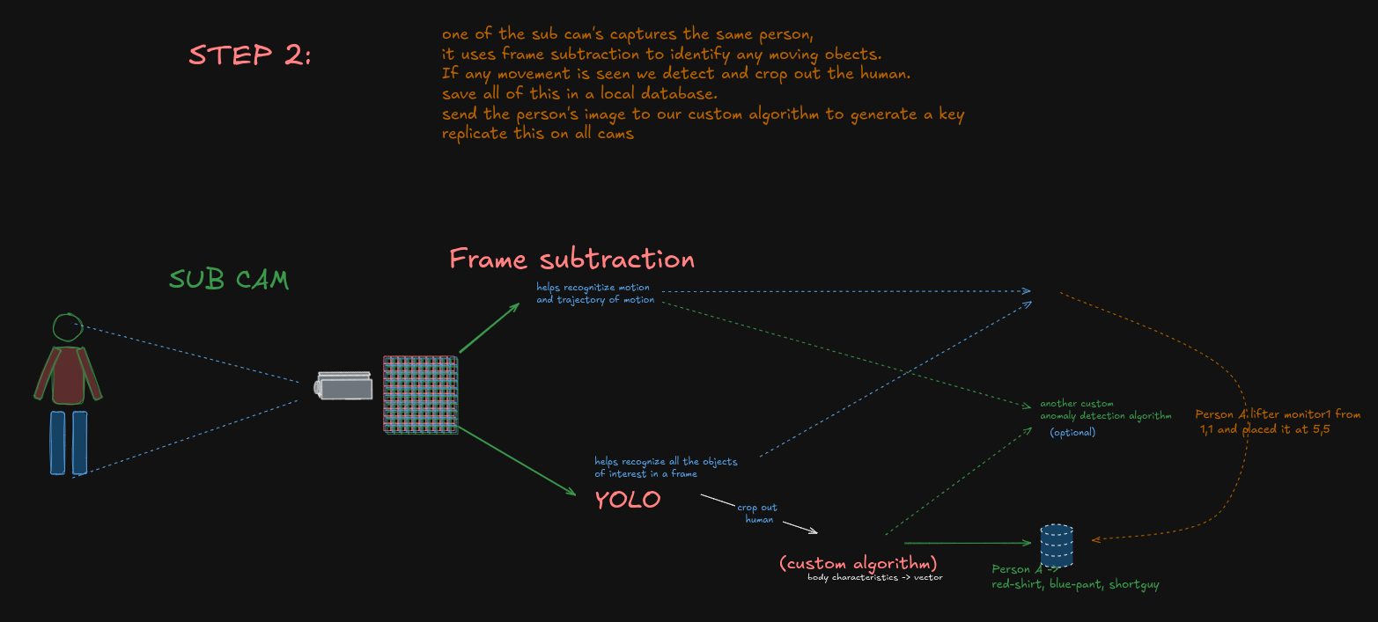
Efficient AI-driven Edge Surveillance using Edge Computing
Proposed Methodology / Approach

Slide 14
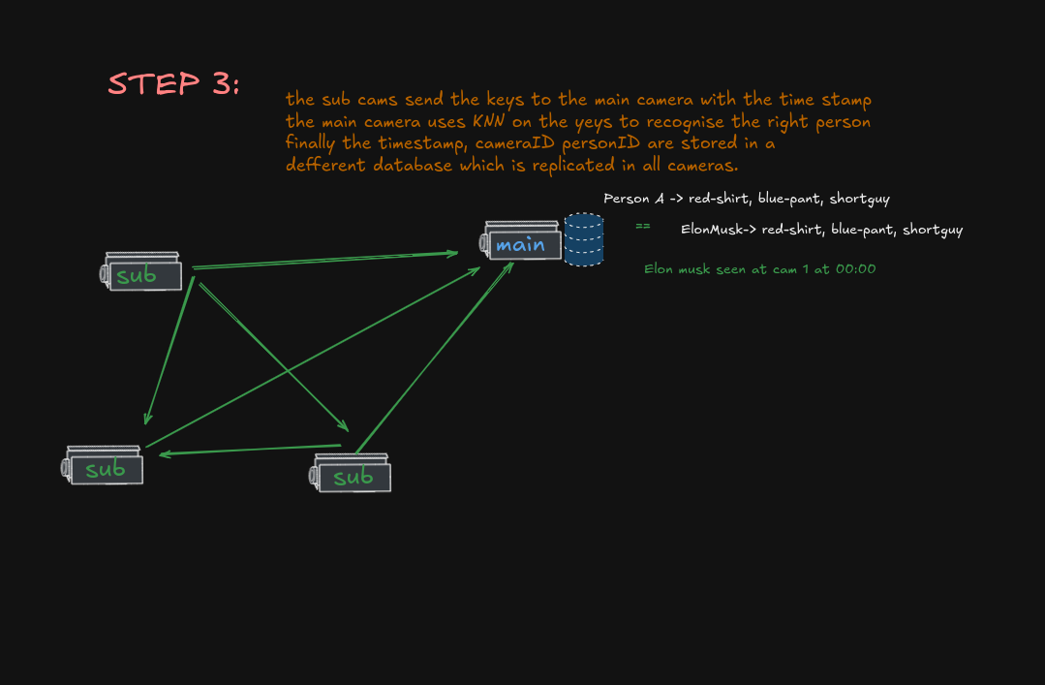
Efficient AI-driven Edge Surveillance using Edge Computing
Proposed Methodology / Approach

Slide 15
Efficient AI-driven Edge Surveillance using Edge Computing
Proposed Methodology / Approach

Slide 16
Efficient AI-driven Edge Surveillance using Edge Computing
Datasets Exploration/ Datasets preprocessing
From the paper: We collected a 18294 image dataset automatically from popular Hollywood movies. The images were obtained by running a state-of-the-art person detector on every tenth frame of 30 movies. People detected with high confidence (roughly 20K candidates) were then sent to the crowdsourcing marketplace Amazon Mechanical Turk to obtain ground truth labeling. Each image was annotated by five Turkers for $0.01 each to label 10 upper body joints. The median-of-five labeling was taken in each image to be robust to outlier annotation. Finally, images were rejected manually by us if the person was occluded or severely non-frontal. We set aside 20% (1016 images) of the data for testing.
Dataset link: https://paperswithcode.com/dataset/flic

Slide 17
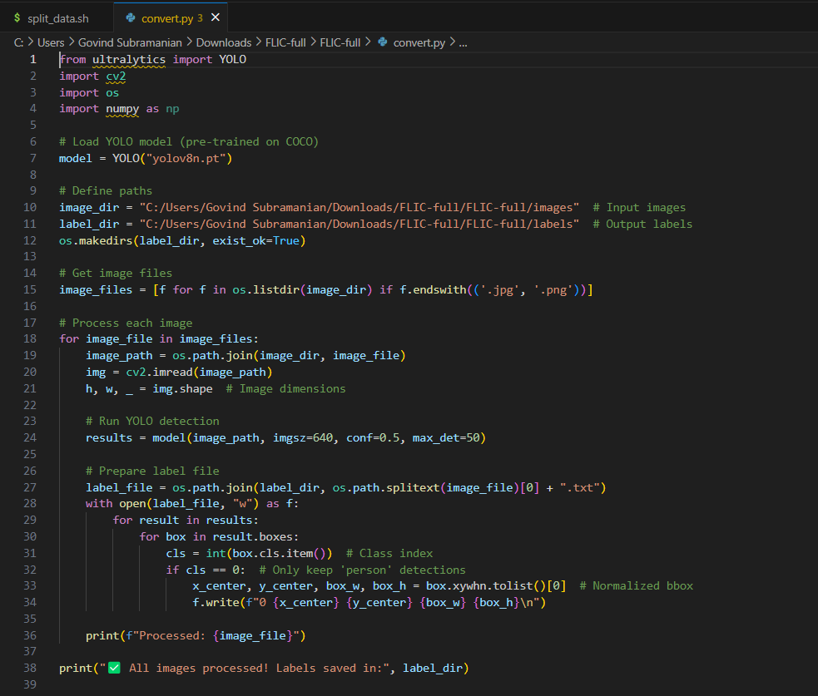
Efficient AI-driven Edge Surveillance using Edge Computing
Datasets Exploration/ Datasets preprocessing

Slide 18
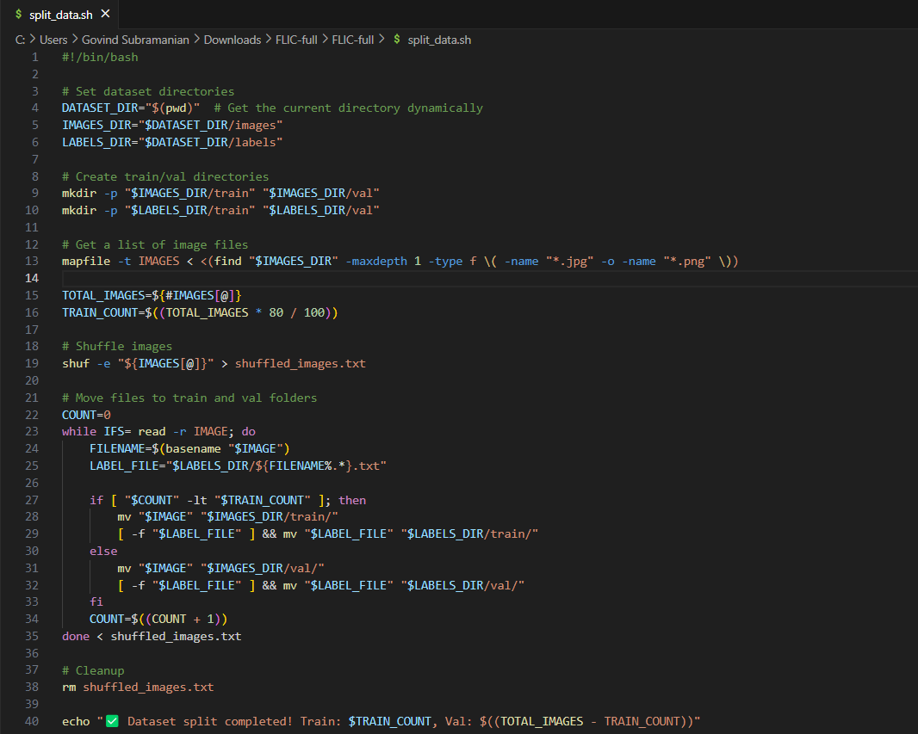
Efficient AI-driven Edge Surveillance using Edge Computing
Datasets Exploration/ Datasets preprocessing

Slide 19
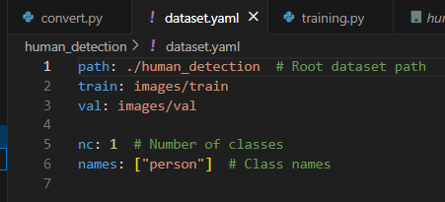
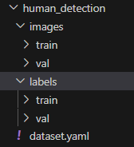
Efficient AI-driven Edge Surveillance using Edge Computing
Datasets Exploration/ Datasets preprocessing

Slide 20
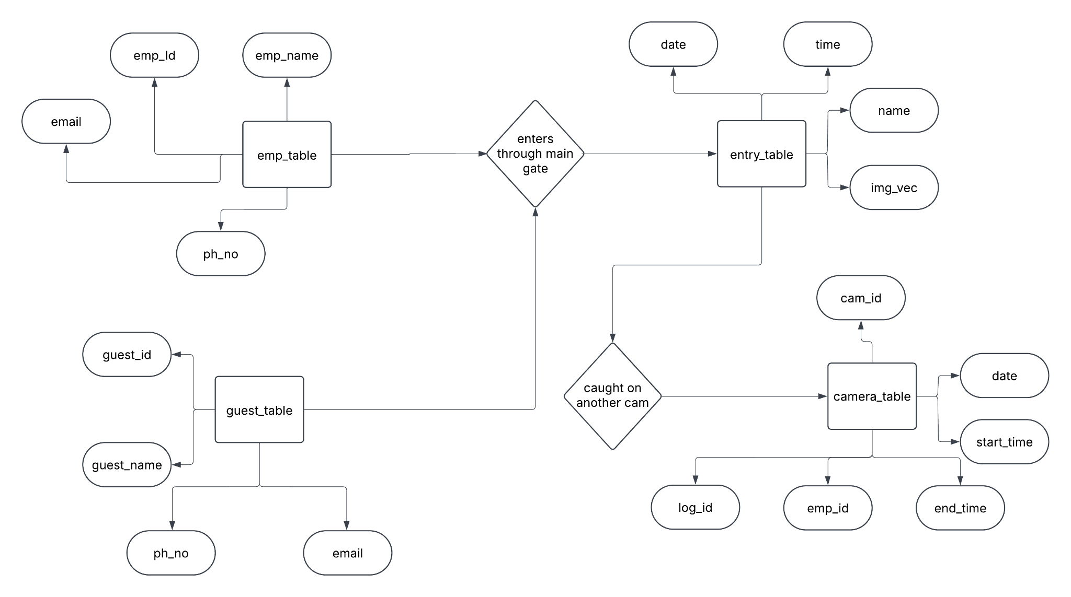
Efficient AI-driven Edge Surveillance using Edge Computing
Control Flow Diagram

Slide 21
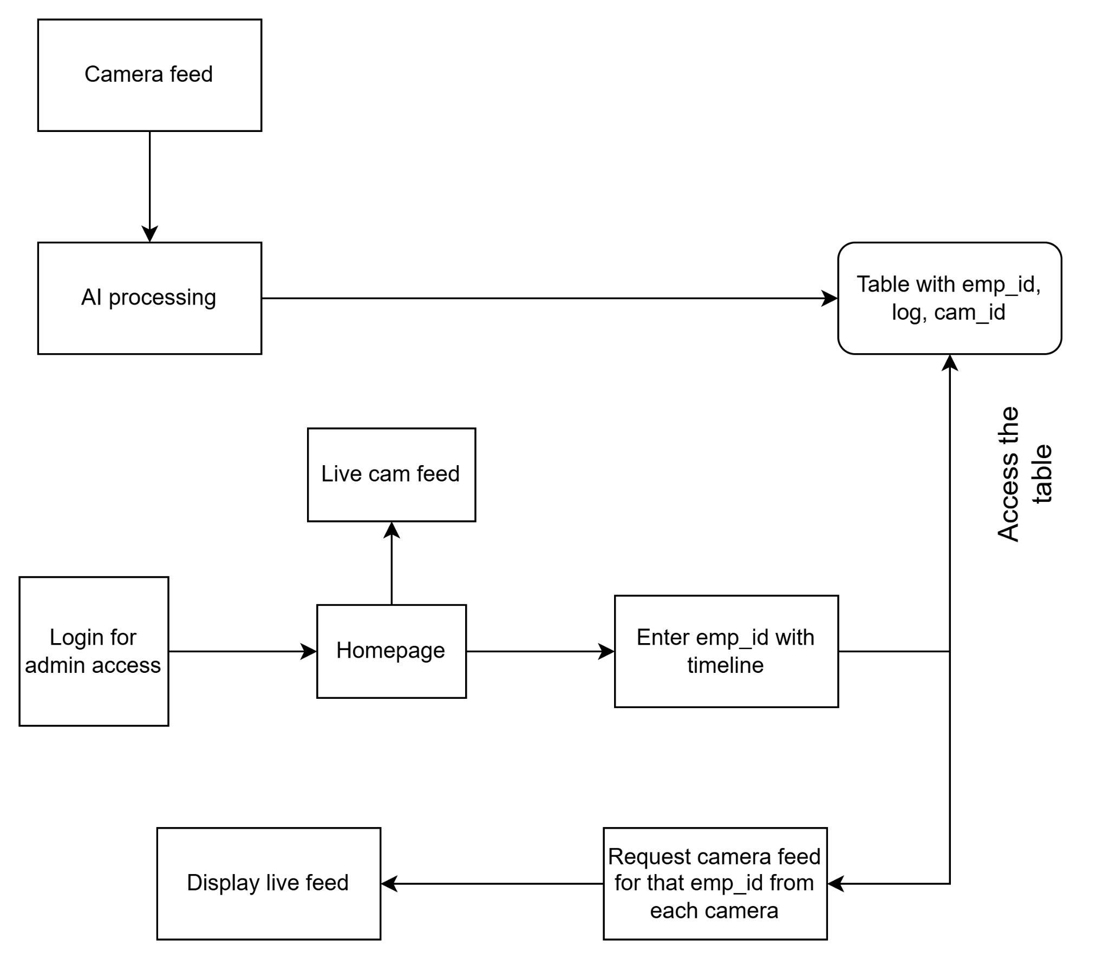
Efficient AI-driven Edge Surveillance using Edge Computing
Control Flow Diagram

Slide 22
Efficient AI-driven Edge Surveillance using Edge Computing
Project Progress Plan for Phase 2
We begin by testing the already available libraries and implementations of cctv and benchmark them on our own chips.
Then we start by making a simple implementation of cctv camera on our pi-zero cam
We benchmark this to other implementations from above and then finally setup the cctv part of it.
Then we begin with training models, one human detection with yolo and another a small cnn to produce vector keys
We benchmark the newly trained models to check if raspberry pi-zero is enough or if a banana-pi is required.
Else if everything fits into our assumptions we can proceed with integration of all the models
We can begin with the DBMS for storage of required records
Finally we can develop a frontend gui to handle all of this .
Implement a small daemon to make sure all databases are in sync.

Slide 23
Efficient AI-driven Edge Surveillance using Edge Computing
References
1. Á. Carro-Lagoa, V. Barral, M. González-López, C. J. Escudero, and L. Castedo, "CITIC Research Center & Department of Computer Engineering, University of A Coruña, 15071, A Coruña, Spain," received Mar. 8, 2023, revised Jul. 26, 2023, accepted Sept. 8, 2023, available online Sept. 12, 2023, version of record Sept. 18, 2023
2.Y. Martínez-Díaz, H. Méndez-Vázquez, L. S. Luevano, L. Chang and M. Gonzalez Mendoza, "Lightweight Low-Resolution Face Recognition for Surveillance Applications," 2020 25th International Conference on Pattern Recognition (ICPR), Milan, Italy, 2021
3. P. Ramya, R. Rajeshwari, “A Modified frame difference method using correlation coefficient for background subtraction”, 6th International Conference On Advances In Computing & Communications, ICACC 2016, 6-8 September 2016, Cochin, India.
4. Jianguo Wang, Xiaomeng Yi, Rentong Guo, Hai Jin, Peng Xu, Shengjun Li, Xiangyu Wang, Xiangzhou Guo, Chengming Li, Xiaohai Xu, Kun Yu, Yuxing Yuan, Yinghao Zou, Jiquan Long, Yudong Cai, Zhenxiang Li, Zhifeng Zhang, Yihua Mo, Jun Gu, Ruiyi Jiang, Yi Wei, Charles Xie. 2021. Milvus: A Purpose Built Vector Data Management System. In Proceedings of the 2021 International Conference on Management of Data (SIGMOD ’21), June 20–25, 2021, Virtual Event, China. ACM, New York, NY, USA, 14 pages. https: //doi.org/10.1145/3448016.3457550 5.Chen, Sheng & Liu, Yang & Gao, Xiang & Han, Zhen. (2018). MobileFaceNets: Efficient CNNs for Accurate Real-Time Face Verification on Mobile Devices. 10.48550/arXiv.1804.07573.

Slide 24
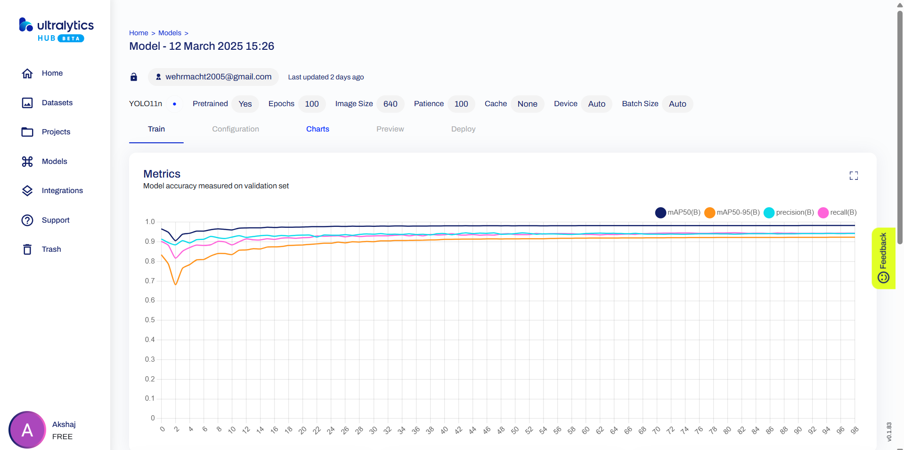
Efficient AI-driven Edge Surveillance using Edge Computing
Any other information
Already started training models on ultralytics hub

Slide 25
Thank You

